Slide 1

Part 3
Management: Empowering People to Achieve Business Objectives

Slide 2
Chapter 11
Production and Operations Management

Slide 3

Chapter Objectives
Outline the importance of production and operations management.
Explain the roles of computers and related technologies in production.
Identify the factors involved in a plant location decision.
Explain the major tasks omaterialsion and operations managers.
Compare alternative layouts for production facilities.
List the steps in the purchasing process.
Outline the advantages and disadvantages of maintaining large inventories.
Identify the steps in the production control process.
Explain the benefits of quality control.

Slide 4
Chapter Overview
Businesses can create or enhance four basic kinds of utility: time, place, ownership, and form
Marketing creates time, place, and ownership utility
Production creates form utility
Notes:
Like marketing, accounting, and human resource management, production and operations management is a vital business function.
Without a marketable good or service, a company cannot create profits, and it soon fails.
The production process is also crucial in a not-for-profit organization, since the good or service it produces justifies the organization’s existence.
Production and operations management plays an important strategic role by lowering the costs of production, boosting output quality, and allowing the firm to respond flexibly and dependably to customers’ demands.

Slide 5
Strategic Importance of the
Production Function
Production—application of resources such as people and machinery to convert materials into finished goods and services.
Production and Operations Management—managing people and machinery in converting materials and resources into finished goods and services.
Notes:
Effective production and operations management can lower a firm’s costs of production, boost the quality of its goods and services, and allow it to respond dependably to customer demands.

Slide 6
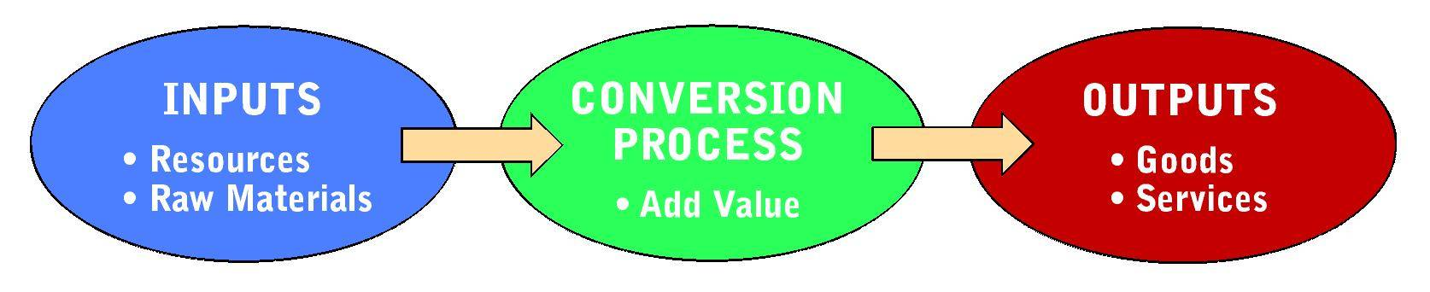
The Production Process: Converting Inputs to Outputs

Slide 7
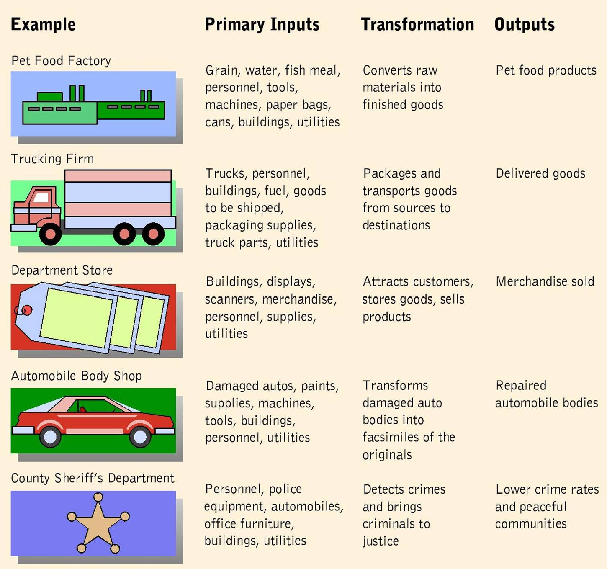
Typical Production Systems

Slide 8
Strategic Importance of the
Production Function
Without production, none of the other functions would operate
Production function adds value to a company’s inputs by converting them into marketable outputs

Slide 9
Strategic Importance of the
Production Function
Mass Production—system for manufacturing products in large amounts through effective combinations of employees with specialized skills, mechanization, and standardization
  Assembly Line—manufacturing technique that carries the product on a conveyor system past several workstations where workers perform specialized tasks.
Notes:
Mass Production
1. A system for manufacturing products in large amounts through effective combinations of employees with specialized skills, mechanization, and standardization
2. Makes outputs available in large quantities at lower prices than individually crafted items would cost, and begins with the specialization of labor, dividing work into its simplest components
3. The assembly line is a manufacturing technique that moves the product along a conveyor belt past a number of workstations, where production workers perform specialized tasks such as welding, painting, installing individual parts, and tightening bolts.

Slide 10
Strategic Importance of the
Production Function
Flexible production—cost-effective system of producing small batches of similar items
Customer-driven production—system that evaluates customer demands in order to link what a manufacture makes with what the customers want to buy
Team concept—combines employees from various departments and functions to work together in designing and building products
Notes:
Flexible Production
1. Can take many forms, but it generally involves:
a. using information technology to share the details of customer orders
b. programmable equipment to fulfill orders
b. skilled people to carry out whatever tasks are needed to fill a particular order.
Customer-Driven Production
1. Evaluates customer demands in order to link what a manufacturer makes with what customers want to buy
2. One method is to establish computer links between factories and retailers’ systems, using data about sales as the basis for creating short-term forecasts and designing production schedules to meet those forecasts.
Team Concept
1. Combines employees from various departments and functions, such as design, manufacturing, finance, and maintenance to work together in designing and building products
2. Concurrent engineering is a concept in which product development brings together: engineers, designers, production staff, marketing personnel, employees from other functions.

Slide 11
Production Processes
Methods of production differ according to firms’ means of operating and time requirements
Means of operating may involve either an analytic or a synthetic system
Time requirements call for either a continuous or an intermittent process
Notes:
1. Analytic production system - reduces a raw material to its component parts in order to extract one or more marketable products
2. Synthetic production system - reverses the method of an analytic system by: combining a number of raw materials or parts, or transforming raw materials to produce finished products.
3. Continuous production process - generates finished products over a period of days, months, or even years in long production runs.
4. Intermittent production process - generates products in short production runs, shutting down machines frequently or changing their configurations to produce different products.

Slide 12
Technology and the Production Process
Robots—reprogrammable machine capable of performing numerous tasks that require manipulations of materials and tools.
  Pick-and-place robots
  Field robots
  Nanotechnology
Notes:
In addition to boosting efficiency in the production process, automation and information technology allow companies to redesign their current methods to enhance flexibility.
Robots
1. a re-programmable machine capable of performing a variety of tasks that require manipulations of materials and tools
2. can repeat the same tasks many times without varying their movements
3. more efficient
4. more consistent than a human, who would grow tired after hours of lifting
Pick-and-place robot
1. Simplest type of robot is the pick-and-place robot
2. moves in only two or three directions
3. as it picks up something from one spot and places it in another
Field robots assist human workers in non-manufacturing, often hazardous, environments, such as: nuclear power plants, space stations, battlefields
Nanotechnology is enabling the use of production techniques that operate at the level of molecules.

Slide 13
Technology and the Production Process
Computer-Aided Design and Computer Aided Manufacturing
  Computer-aided design (CAD)—system for interactions between a designer and a computer to design a product, facility or part the meets predetermined specifications.
Notes:
CAD - enables engineers to design parts and buildings on computer screens faster and with fewer mistakes than they could achieve working with traditional drafting systems.

Slide 14
Technology and the Production Process
Computer-Aided Design and Computer Aided Manufacturing
  Computer-aided manufacturing (CAM)—electronic tools to analyze CAD output and determine necessary steps to implement the design, followed by electronic transmission of instructions to guide the activities of production equipment.
Notes:
CAM picks up where the CAD system leaves off
Computer tools that enable a manufacturer to analyze the steps that a machine must take to produce a needed product or part.
Both CAD and CAM technologies are now used together at most modern production facilities.

Slide 15
Technology and the Production Process
Flexible manufacturing system (FMS) production facility that workers can quickly modify to manufacture different products
Computer-integrated manufacturing (CIM) protection system that integrates computer tools and human workers to design products, handle materials, and control production
Notes:
Flexible Manufacturing Systems (FMS)
Typical system consists of:
1. computer-controlled machine centers to produce metal parts
2. robots to handle the parts
3. remote-controlled carts to deliver materials
4. Entering a new, more user-friendly generation with the development of software called OpenCNC
5. Virtual Engineered Composites (VEC) use digital commands to drive the manufacturing process, and operate in a box which can be as small as a mop bucket or as large as a freight container.
Computer-Integrated Manufacturing (CIM)
1. A production system in which computers help workers to:
design products, control machines, handle materials, control the production function in an integrated fashion.
2. The key to CIM is a centralized computer system that integrates and controls separate processes and functions.
3. The Internet is advancing the integration of manufacturing and linking it to marketing and other activities.

Slide 16
The Location Decision
The best locations provide advantages in three categories:
  Transportation
  Physical
  Human factors
Environmental impact study—analyzes how a proposed plant would affect the quality of life in the surrounding area
Notes:
A. Choosing the right place to set up a production facility is one of a firm’s major decisions.
B. Transportation factors include:
1.Proximity to markets and raw materials
2. Availability of alternative modes for transporting both inputs and outputs.
C. Physical variables involve such issues such as: Water supplies, Available energy, Options for disposing of hazardous wastes.
D. Human factors include an area’s labor supply, local regulations, and living conditions.

Slide 17
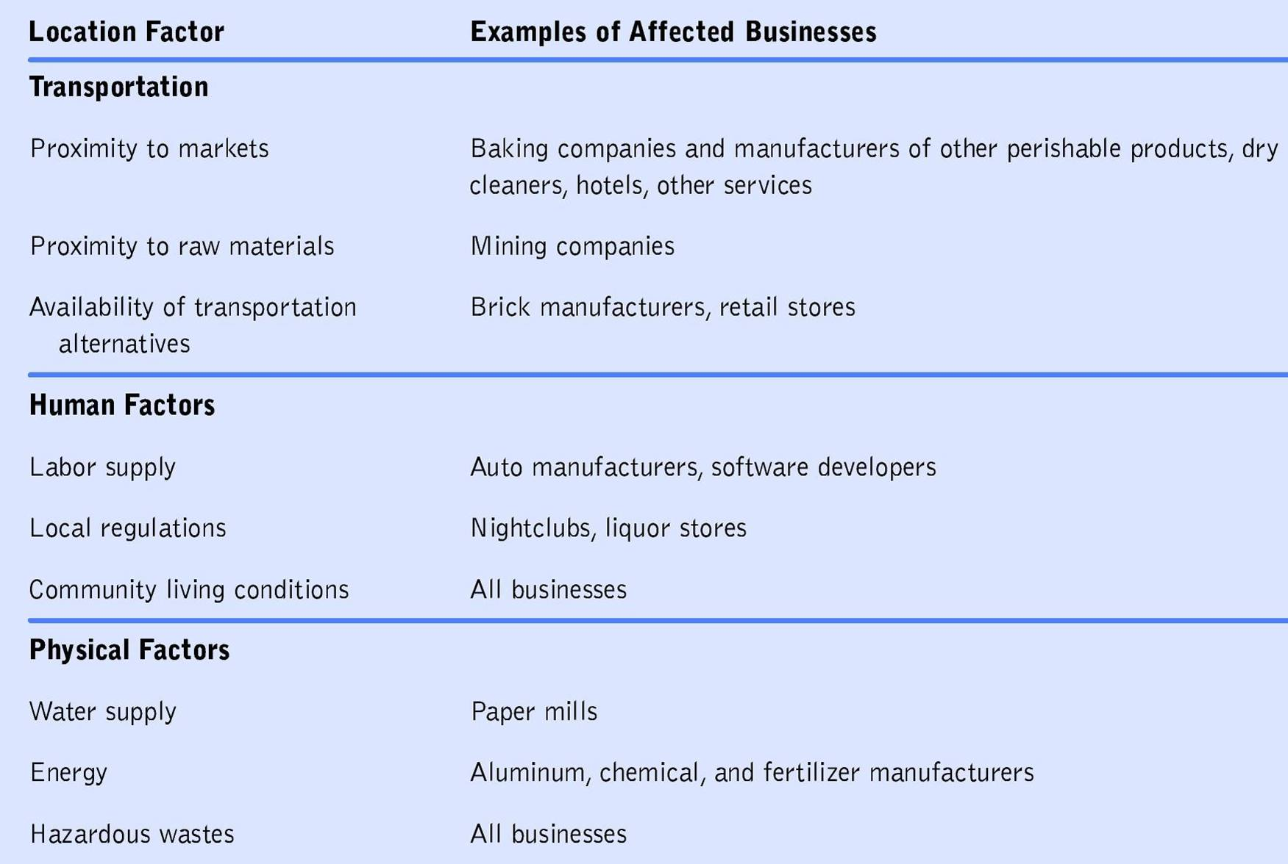
Factors in the Location Decision

Slide 18
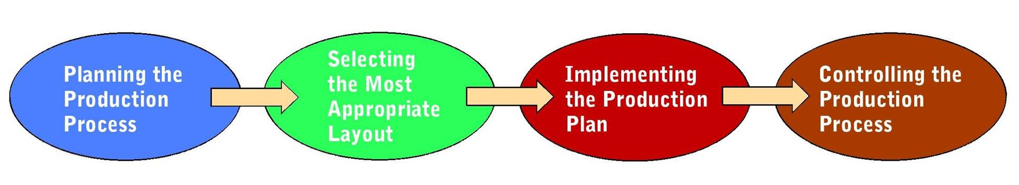
The Job of Production Managers
Production Management Tasks
Notes:
Oversee the work of people and machinery to convert inputs (materials and resources) into finished goods and services.
Perform four major tasks:
1. planning the overall production process
2. determining the best layout for the firm’s production facilities
3. implementing the production plan
4. controlling the production process to maintain the highest possible quality.

Slide 19
The Job of Production Managers
Planning the Production Process
  Marketing research studies:
    Solicit consumer reactions to proposed products
    Test prototypes of new items
    Estimate their potential sales and profitability levels
  Production push
  Production pull
Notes:
Planning the Production Process
1. Begins with its choice of the goods or services to offer its customers
2. Other decisions such as machinery purchases, pricing decisions, and selection of retail outlets all grow out of product planning
3. Marketing research studies elicit consumer reactions to proposed products, test prototypes of new items, and estimate their potential sales and profitability levels.
4. The production department concerns itself with:
a. converting original product concepts into final specifications
b. designing the most efficient facilities to produce the new product.
5. Production planning can also benefit from the insights of suppliers and product engineers
6. Production push—production drive sales
7. Production pull—sales drive production

Slide 20
The Job of Production Managers
Determining the Facility Layout
  Determining the best layout for the facility requires managers to consider all phases of production and the necessary inputs at
  each step
    Process Layout
    Product Layout
    Fixed-Position Layout
    Customer-Oriented Layout
Notes:
process
•groups machinery and equipment according to their functions
•often facilitates production of a variety of nonstandard items in relatively small batches
product
•sets up production equipment along a product-flow line and the work in process moves along this line past workstations
•efficiently produces large numbers of similar products
fixed-position
•places the product in one spot and workers, materials, and equipment come to it
•suits production of a very large, bulky, heavy, or fragile product.
customer-oriented
Service organizations also must decide on appropriate layouts for their production processes.

Slide 21
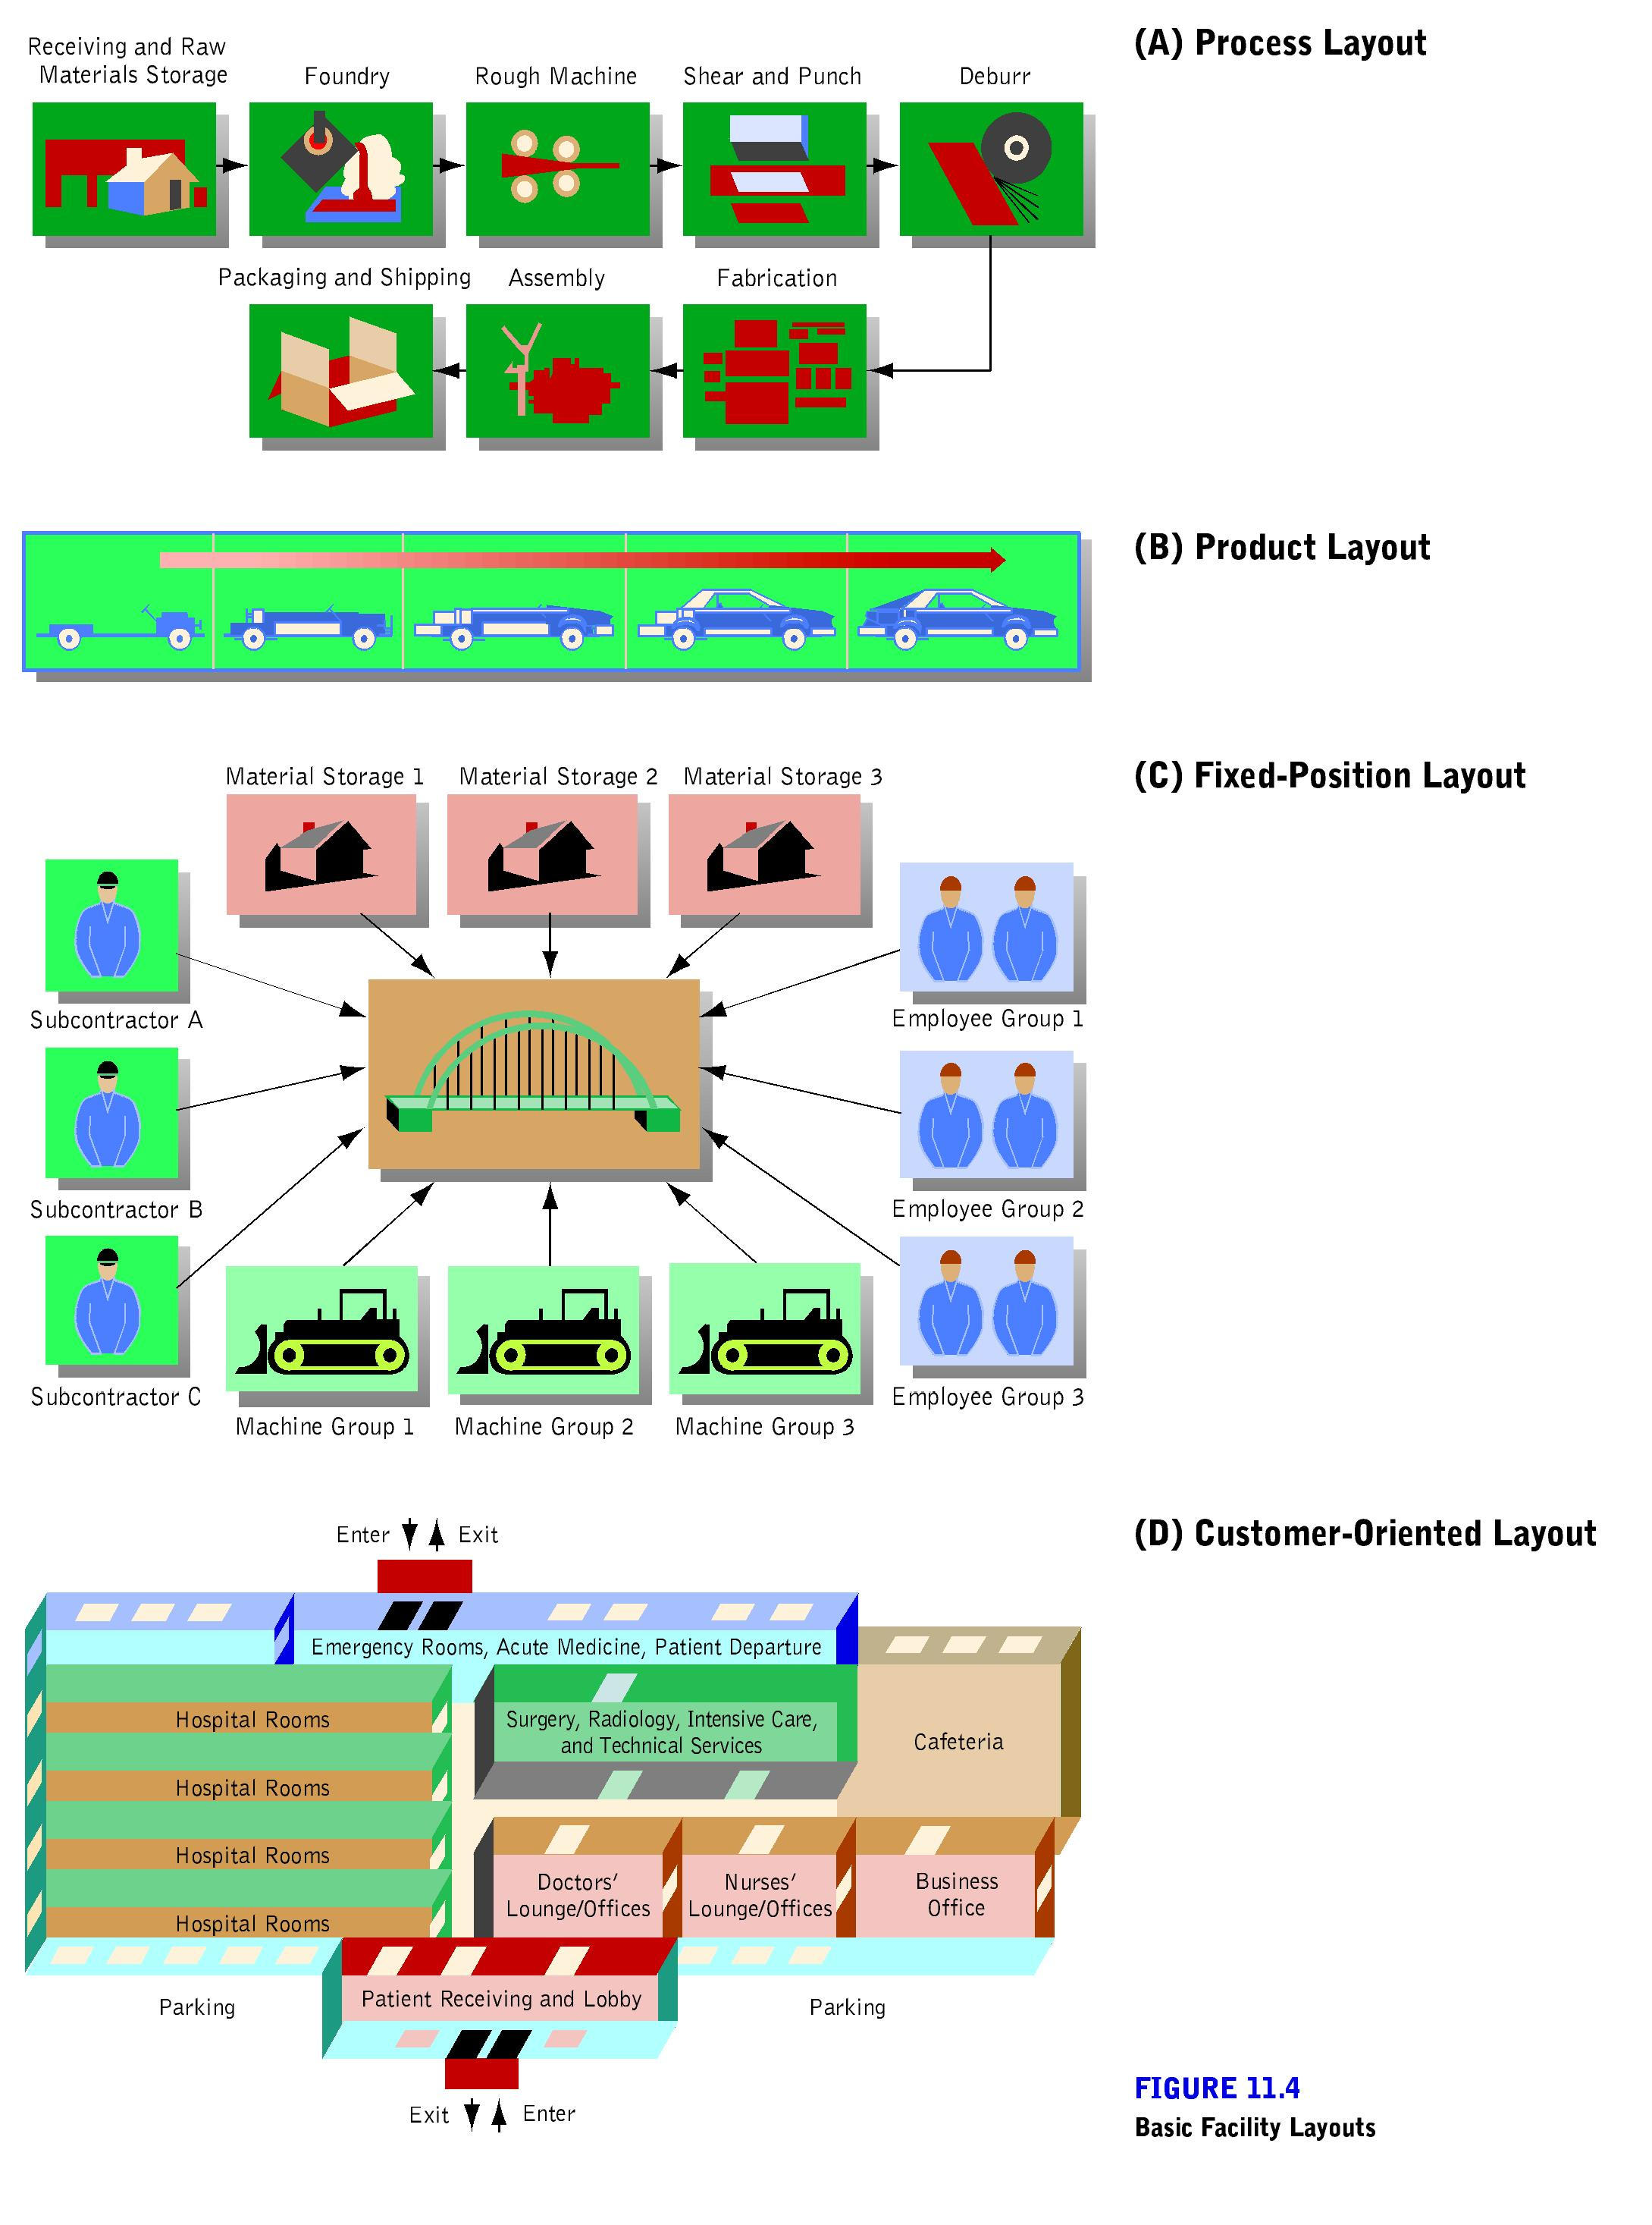
Process Layout and Product Layout

Slide 22
Fixed-Position Layout

Slide 23
Customer-Oriented Layout

Slide 24
The Job of Production Managers
Implementing the Production Plan
  Make, buy, or lease decision: choosing whether to manufacture a needed product or component in house, purchase it from an outside supplier, or lease it
Notes:
Implementing the Production Plan
a. deciding whether to make, buy, or lease components
b. selecting the best suppliers for materials
c. controlling inventory to keep enough on hand.
Make, Buy, or Lease Decision
a. one of the fundamental decisions facing every firm
b. choosing whether to manufacture a needed product or component in house, purchase it from an outside supplier, or lease it
c. several factors affect the decision, including the costs of leasing or purchasing parts from outside suppliers compared with the costs of producing them in-house
d. sometimes hinges on the availability of outside suppliers that can dependably meet standards for quality and quantity.

Slide 25
The Job of Production Managers
Selection of Suppliers
  Managers compare quality, prices, dependability of delivery, and services offered by competing suppliers
Notes:
1. Once a company decides what inputs to purchase, it must choose the best vendors for its needs
2. Must compare competitors’: quality, prices, dependability of delivery, services offered
3. For a major purchase, negotiations between the purchaser and potential vendors may stretch over several weeks or even months
4. The final buying decision may rest with a number of colleagues who must finalize the decision
5. The Internet has given buyers powerful tools for finding and comparing suppliers
6. Firms often purchase raw materials and component parts on long-term contracts, which helps to ensure availability.

Slide 26
The Job of Production Managers
Inventory Control
  Requires balancing the need to keep stocks on hand to meet demand against the expenses of carrying the inventory
  Perpetual inventory: system that continuously monitors the amounts and location of inventory
  Vendor-managed inventory: system that hands over a firm’s inventory control functions to suppliers
Notes:
1. production managers must balance the need to keep stocks on hand to meet demand against the costs of carrying the inventory.
2. among the expenses involved in storing inventory are:
warehousing costs, taxes, insurance, maintenance.
3. Many firms maintain perpetual inventory systems to monitor the amounts and locations of their stocks continuously.
4. Some companies go further and hand over their inventory control functions to suppliers, which is called vendor-managed inventory.
5. Some firms have modified vendor-managed inventory approaches called CPFAR - a planning and forecasting technique involving collaborative efforts by both purchasers and vendors.

Slide 27
The Job of Production Managers
Implementing the Production Plan
  Just-in-Time System—management philosophy aimed at improving profits and return on investment by minimizing costs and eliminating waste through cutting inventory on hand.
Notes:
a. implements a broad management philosophy that reaches beyond the narrow activity of inventory control to influence the entire system of production and operations management
b. seeks to eliminate all sources of waste - anything that does not add value - by providing the right part at the right place at the right time
c. the inventory control function supplies parts to a production line or an entire company, as they are needed
d. production using JIT shifts much of the responsibility for carrying inventory to vendors, which operate on forecasts and keep stocks on hand to respond to manufacturers’ needs
e. producers address the risks of JIT by building long-term relationships with suppliers who demonstrate their ability to meet high standards

Slide 28
The Job of Production Managers
Implementing the Production Plan
  Material Requirement Planning (MRP)—computer-based production planning system by which a firm can ensure that it has needed parts and materials available at the right time and place in the correct amounts.
Notes:
a. a computer-based production planning system
b. lets a firm ensure that it has all the parts and materials it needs to produce its goods and services at the right time and place and in the right amounts
c. production managers use MRP programs to create schedules that identify the specific parts and materials required to produce an item.

Slide 29
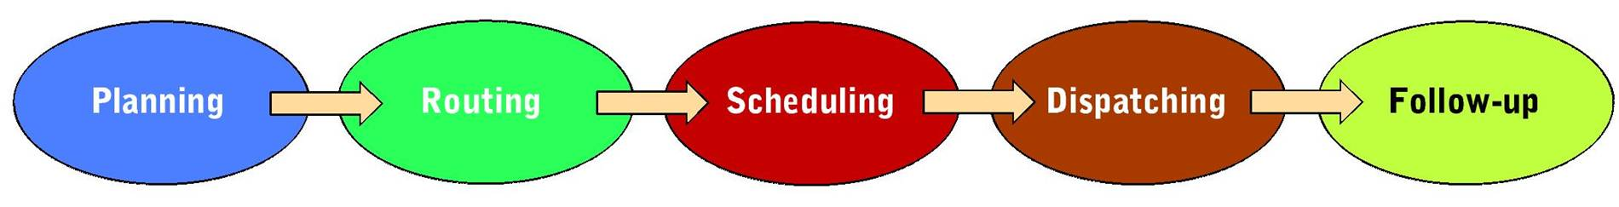
The Job of Production Managers
Controlling the Production Process
  Production control: creates a well-defined set of procedures for coordinating people, materials, and machinery to provide maximum production efficiency
Steps in Production Control
Notes:
1. After planning, determining plant layout, and implementing the production plan comes the final task of controlling the production process to maintain the highest possible quality.
2. Creates a well-defined set of procedures for coordinating people, materials, and machinery to provide maximum production efficiency

Slide 30
The Job of Production Managers
Controlling the Production Process
  Production planning—determines the amount of resources (including raw materials and other components) a firm needs to produce a certain output
  Routing—determines the sequence of work throughout the facility and specifies who will perform each aspect of production at what location
Notes:
Production Planning
a. determines the amount of resources - including raw materials and other components - a firm needs to produce a certain output
b. develops a bill of materials that lists all needed parts and materials
c. ensures the availability of needed machines and workers.
Routing
a. determines the sequence of work throughout the facility
b. specifies who will perform each aspect of production at what location
c. depend on two factors:
•the nature of the good or service
•the facility layouts - product, process, fixed-position, or customer-oriented.

Slide 31
The Job of Production Managers
Controlling the Production Process
  Scheduling—development of timetables that specify how long each operation in the production process takes and when workers should perform it.
Notes:
a. the production managers develop timetables that specify how long each operation in the production process takes and when workers should perform it
b. efficient scheduling ensures that production will meet delivery schedules and make efficient use of resources
c. use a number of analytical methods for scheduling including the Gantt chart, which tracks projected and actual work progress over time
d. complex project might require a PERT (Program Evaluation and Review Technique) chart, which seeks to minimize delays by coordinating all aspects of the production process.

Slide 32
The Job of Production Managers
Controlling the Production Process
  Gantt chart—tracks projected and actual work progress over time
  PERT (Program Evaluation and Review Technique)—chart which seeks to minimize delays by coordinating all aspects of the production process
    Critical Path—sequence of operations that requires the longest time for completion

Slide 33
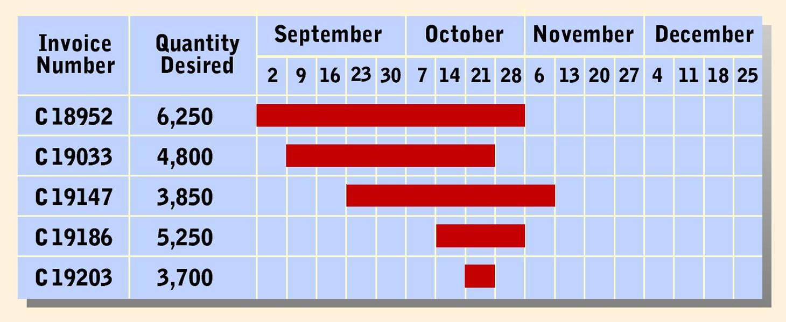
Sample Gantt Chart

Slide 34
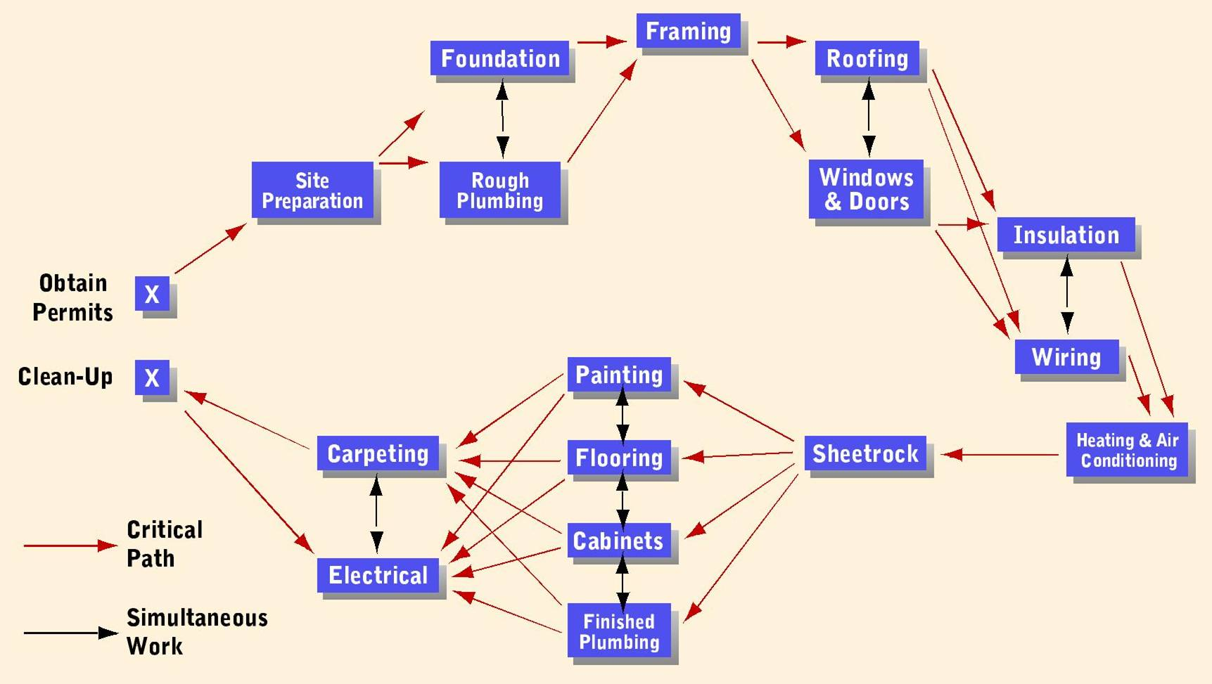
PERT Diagram for Building a Home

Slide 35
The Job of Production Managers
Controlling the Production Process
  Dispatching—phase of production control in which the manager instructs each department on what work to do and time allowed for its completion
  Follow-Up—phase of production control in which employees and their supervisors spot problems in the production process and determine needed adjustments
Notes:
Dispatching
a. instructions for what work each department will do and the time allowed for its completion
b. the dispatcher authorizes performance, provides instructions, and lists job priorities.
Follow-Up
a. the phase of production control in which employees and their supervisors spot problems in the production process and determine needed adjustments
b. problems can take many forms, including: machinery malfunctions, delayed shipments, employee absenteeism

Slide 36
Importance of Quality
Quality is vital in all areas of business, including the product development and production functions
Cost of quality is ultimately reduced by investing money up front in quality design and development
Typical costs of poor quality include downtime, repair costs, rework, and employee turnover
Notes:
Quality control involves evaluating goods and services against established quality standards. Such checks are necessary to spot defective products and to see that they are not shipped to customers.
Devices for monitoring quality levels of the firm’s output include visual inspection, electronic sensors, robots, and x-rays.
Quality is just as vital in product development; investing more money up front in quality design and development ultimately decreases the costs of quality.

Slide 37
Importance of Quality
Benchmarking—identifying how leaders in certain fields perform and continually comparing and measuring performance against these outstanding performers.

Slide 38
Importance of Quality
Quality Control—measuring goods and services against established quality standards.
ISO Standards
  International Organization for Standardization—organization whose mission is to promote the development of standardized products to facilitate trade and cooperation across national borders.
Notes:
Quality Control
Ways to monitor quality levels of a firm’s output include: visual inspections, electronic sensors, robots, X-rays.
ISO (International Organization for Standardization) Standards
1. established in Europe in 1947
2. includes representatives from about 130 nations
3. its mission is to promote the development of standardized products to facilitate trade and cooperation across national borders.
4. Govern everything from camera film speeds to the thickness of credit cards and even the terminology of international measurement units and the symbols for automobile controls.

